Slide 1




SMART UNIVERSITY ERP
OOAD — FINAL REVIEW
An Object-Oriented Approach to University Management
Sai Harini Singineedi — 24B11IT097
Nalli Praneesha — 24B11IT072
Pedapudi Snehalatha — 24B11IT083
Muralasetti Anantha Lakshmi — 25B21IT007
Aditya University

Slide 2

Introduction
01
02
03
The Need
The Problem
The Solution
Universities handle student information, attendance, assignments, examinations and results.
Separate records and systems cause duplicated data, inconsistency and delayed access.
One centralized platform for academic and administrative activities, including academic-risk monitoring.
Objective: design a centralized university management system using object-oriented analysis and design.

Slide 3


Why OOAD and UML?
OOAD
UML
Analyzing and designing a system as interacting objects and classes.
Visual models of structure, behavior, interactions and deployment.
Modularity
Reusability
Maintainability
Scalability
Real-world modeling
Use Case Diagram
Sequence Diagram
Class Diagram
Activity Diagram
Component Diagram
State Chart Diagram
Deployment Diagram

Slide 4

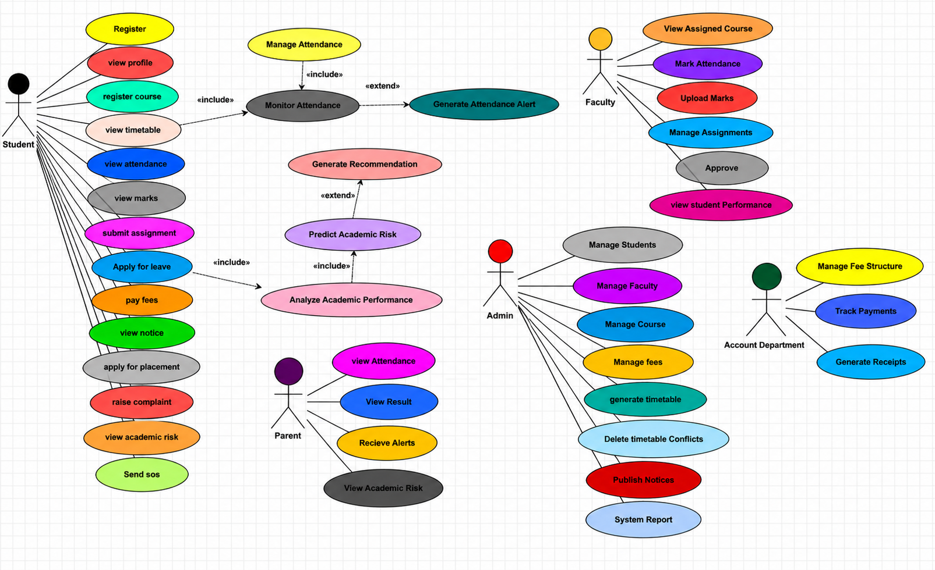

Use Case Diagram
Actors and their interactions with the system.
[INSERT USE CASE DIAGRAM HERE]
Student: academic information, attendance, assignments, timetable, results
Parent: monitors linked student’s progress and updates
Faculty: attendance, assignments, marks
Administrator: records, users, academic information
Use cases: login, view information, manage attendance, assignments and results, notifications

Slide 5

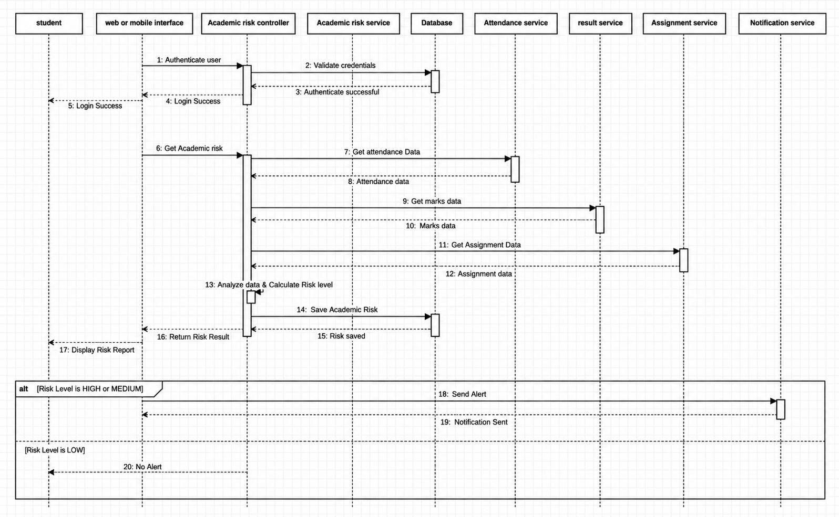
Sequence Diagram
Interactions over time: academic-risk analysis.
[INSERT SEQUENCE DIAGRAM HERE]
User accesses the application
Request sent to the academic-risk controller
Attendance, exam and assignment data retrieved
Risk service analyzes performance data
Assessment and recommendations returned
Interface shows result; notification if supported

Slide 6
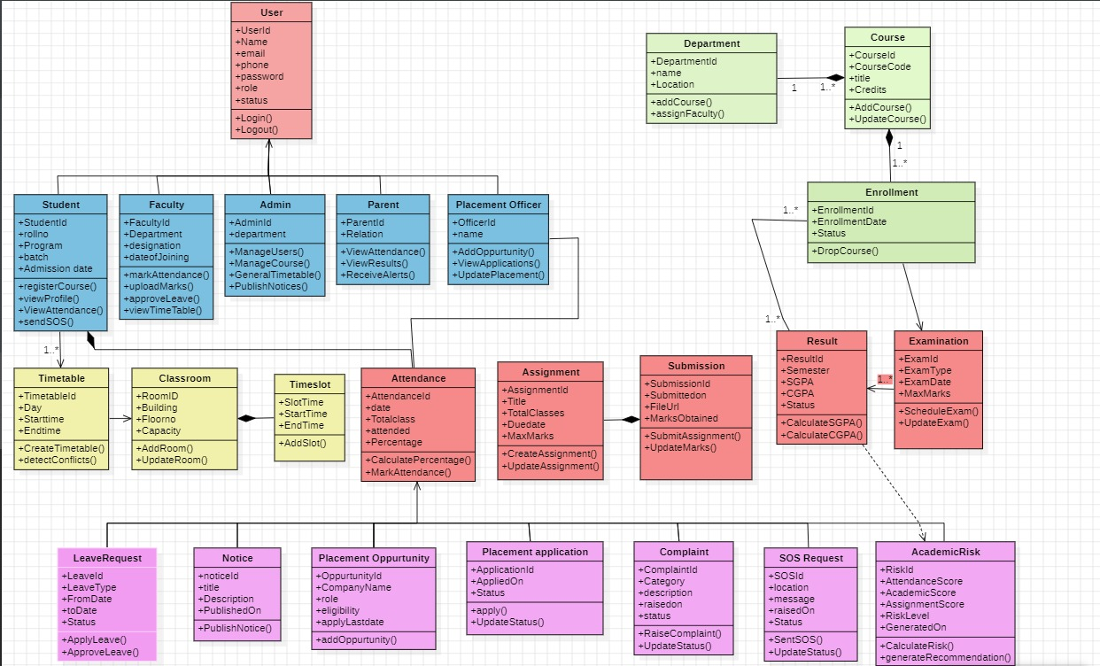
Class Diagram
Static structure: classes, attributes, methods and relationships.
[INSERT CLASS DIAGRAM HERE]
Student, Parent, Faculty
Course, Attendance
Assignment, Result
Notification
These classes model the entities and relationships in university management

Slide 7
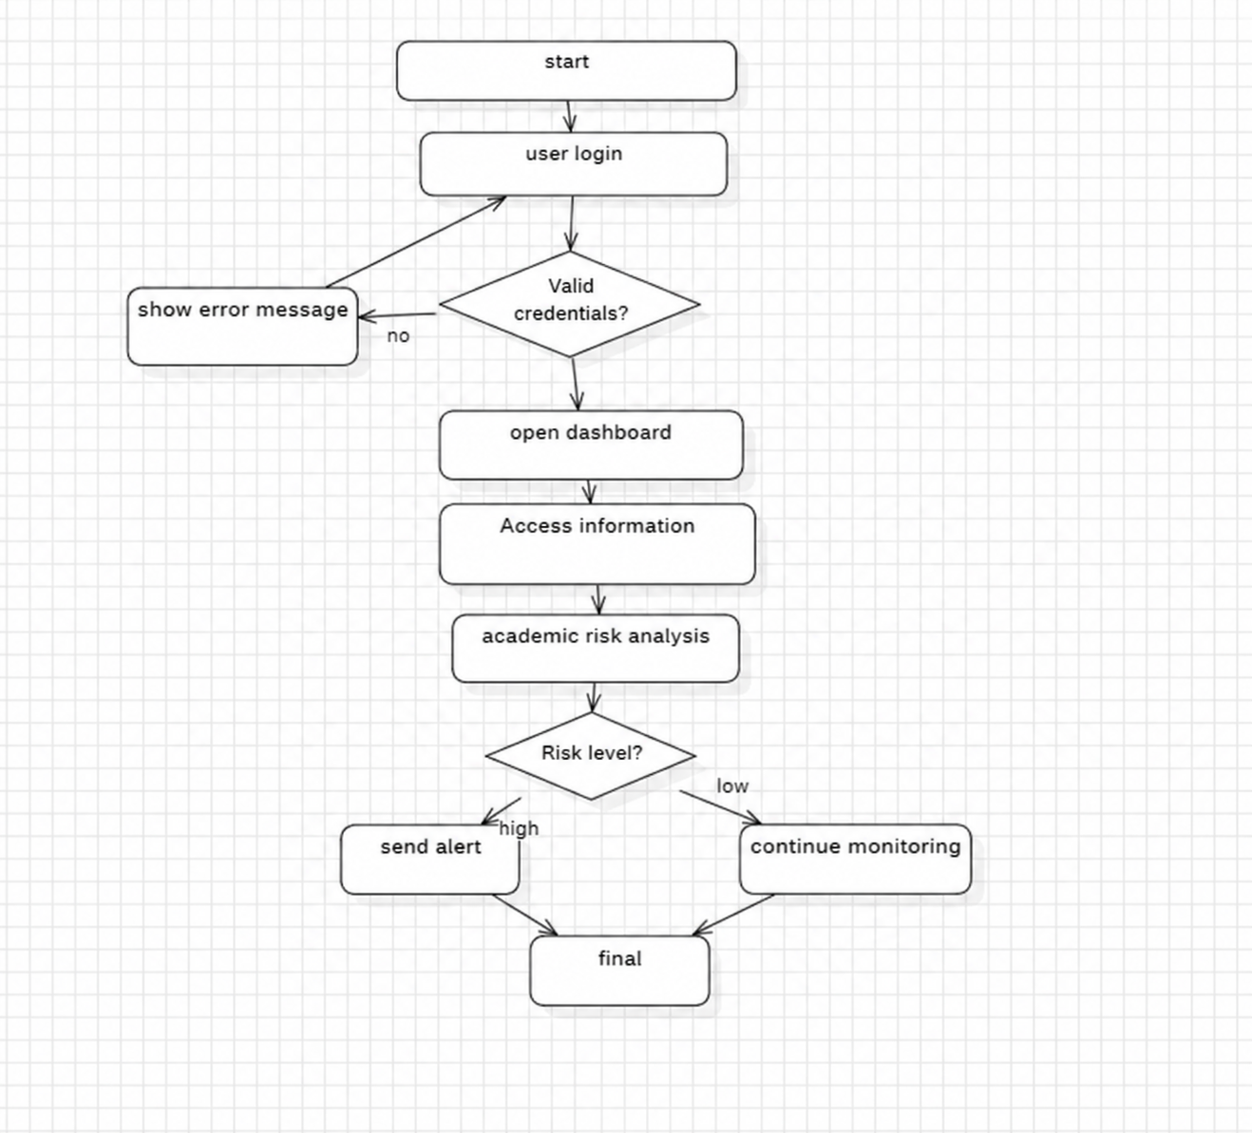
Activity Diagram
Workflow of actions, decisions and transitions: academic-risk analysis.
[INSERT ACTIVITY DIAGRAM HERE]
Start; user logs in
System validates login
Performance data retrieved
Attendance, marks, assignments analyzed
Academic risk assessed (decision branches by risk level)
Assessment and recommendations displayed
Notification if required; End

Slide 8
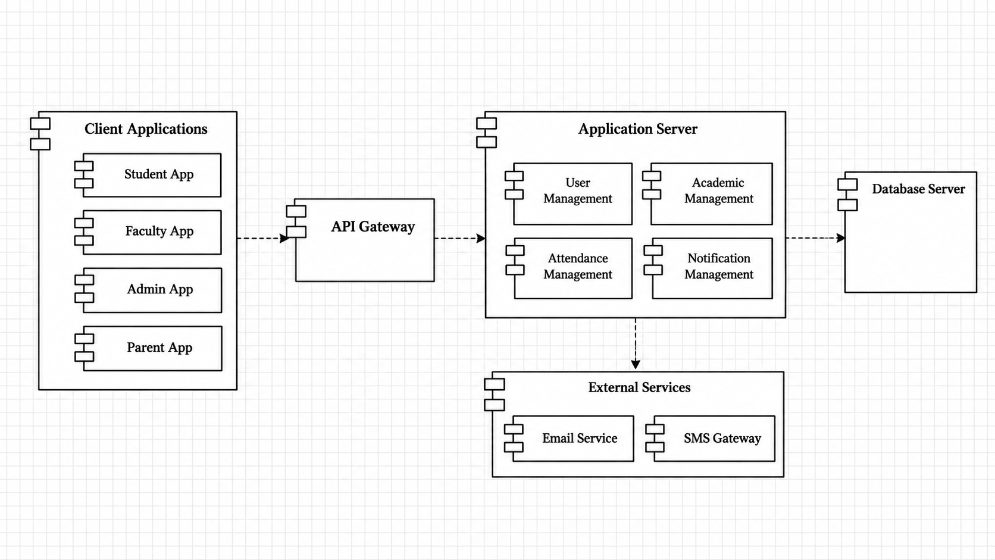
Component Diagram
Major software modules and their dependencies.
[INSERT COMPONENT DIAGRAM HERE]
User Interface
User Management
Student Management
Academic Management
Academic Risk Analysis
Notification Management
Database
Components cooperate through defined dependencies

Slide 9
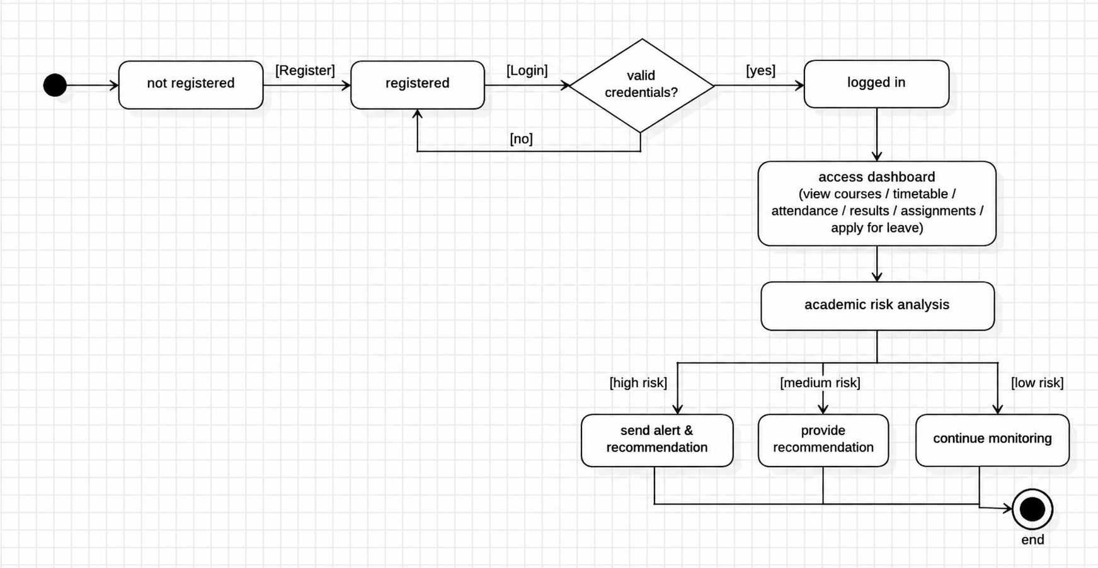
State Chart Diagram
States of an object and the events that trigger transitions.
[INSERT STATE CHART DIAGRAM HERE]
Example states: Normal, Monitoring, At Risk, High Risk, Improved
Changes in attendance, marks and assignment performance trigger reassessment
Example only: states should match the actual project design

Slide 10
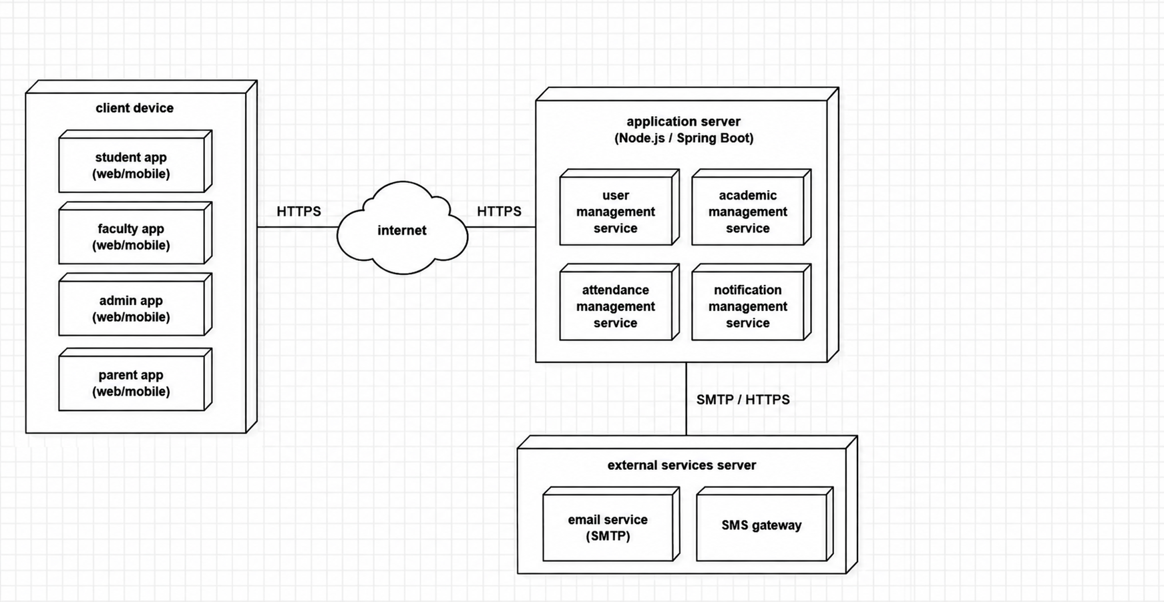
Deployment Diagram
Runtime environment and the nodes where software runs.
[INSERT DEPLOYMENT DIAGRAM HERE]
Client Device → User Interface → Application Server → Database Server
Application Services run on the application server
Show the actual architecture; if run locally, depict a local-development setup

Slide 11
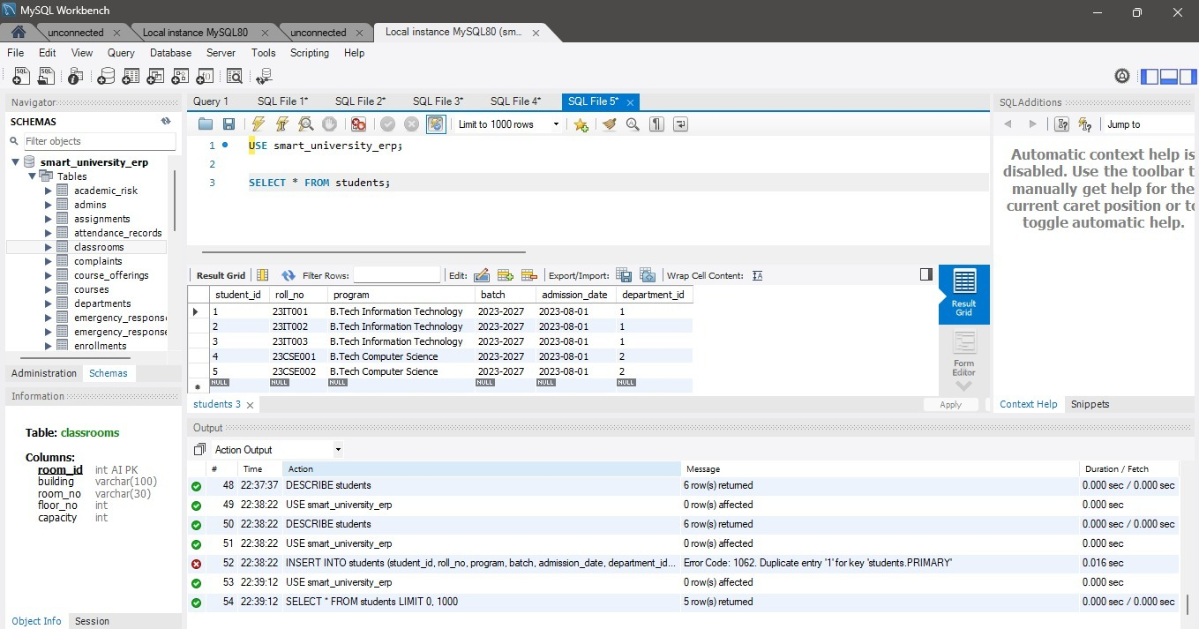
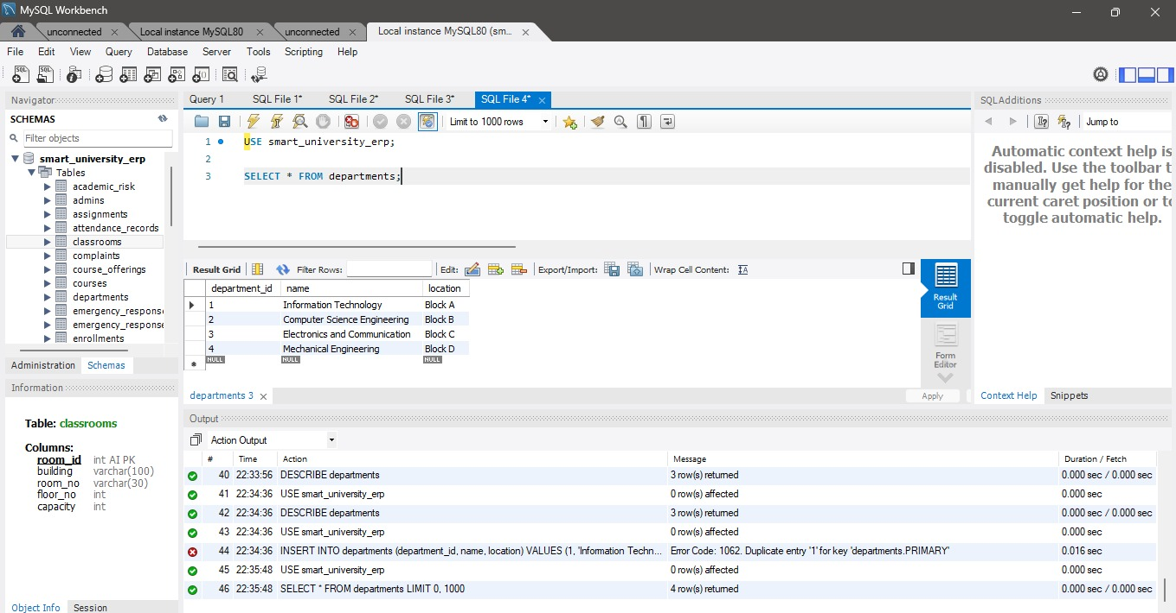
Database Implementation
[INSERT DATABASE SCHEMA / STRUCTURE SCREENSHOT HERE]
students — student information
faculty — faculty information
attendance — attendance records
results — academic results

Slide 12
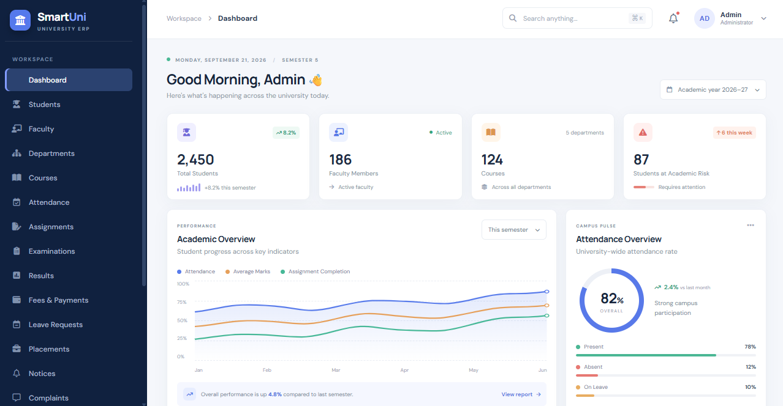
Smart University ERP Application
User-facing interface to supported university management features.
[INSERT SMART UNIVERSITY ERP APPLICATION SCREENSHOT HERE]
Login and authentication, if implemented
Student and academic information
Attendance, assignments, examination records
Performance monitoring and notifications
Workflow: access → log in → select function → system displays information

Slide 13
Conclusion
Achieved in Design
Future Work
Actors and requirements identified
Structure and behavior shown in UML
Functionality organized into modules
Database designed for university data
Extensible as requirements evolve
Improved academic-risk analysis
Additional reports
Notification integrations
Enhanced security
OOAD and UML give a systematic way to analyze, design and document the proposed university management system.

Slide 14

THANK YOU
Smart University ERP
Questions and Answers
Aditya University

